Slide 1
Rutland middle School (RMS) FUTURE
Rutland Middle School (RMS) Parent Advisory Committee (PAC) Meeting
TUESDAY FEBRUARY 19th, 2019

Slide 2
Welcome
Introductions of Guests
School District 23 Trustees
Moyra Baxter, Rolli Cacchioni, Norah Bowman, & Julia Fraser
School District 23 Staff:
Mitch Vanaller, Eileen Sadlowski, Jon Rever
Agricultural Land Commission Committee Member:
Gerry Zimmermann

Slide 3
Purpose:
Discuss RMS current situation & future.
Communicate any further correspondence from the Ministry of Education.
Allow for parents to ask questions.
Discuss further strategies to lobby the government.

Slide 4


“Where everybody is a somebody”

Slide 5
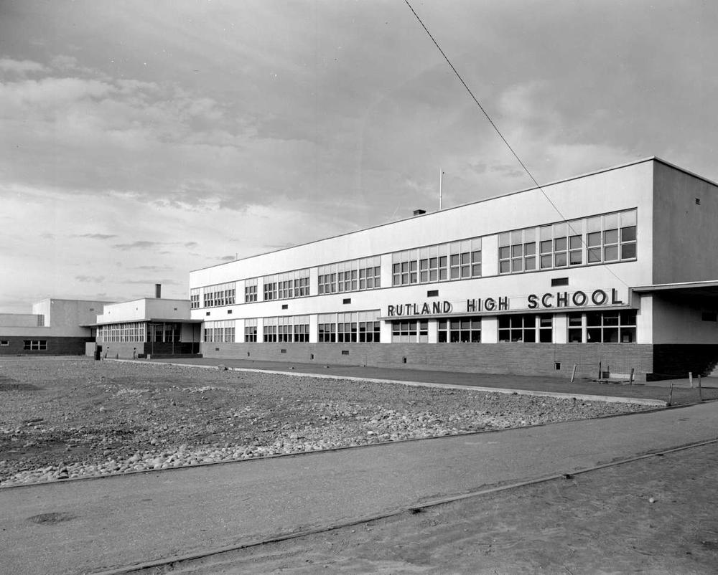
History of Rutland Middle School
Originally constructed in 1948
Opened in 1949 as Rutland High School (Grades 7 -12).
1972 Rutland High School became Rutland Junior Secondary School (Grade 8-10)
because Rutland Senior Secondary School opened.
1993 Rutland Junior became Rutland Middle School (grade 7-9).
2016 Rutland Middle School shifted to Grade 6-8.
Several generations of Rutland area families have attended this school since 1949.
1952 – Rutland High School – BC Archives
https://search-bcarchives.royalbcmuseum.bc.ca/rutland-high-school-2

Slide 6
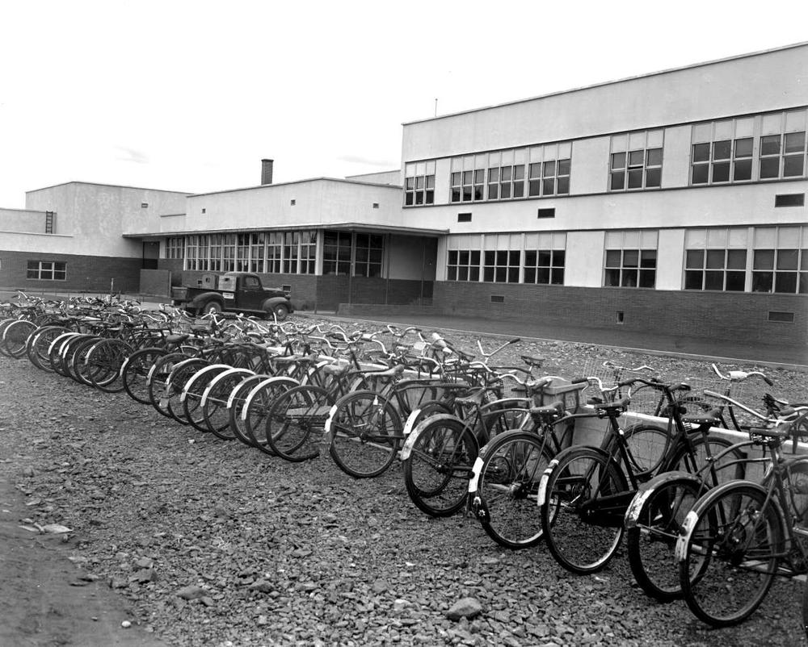
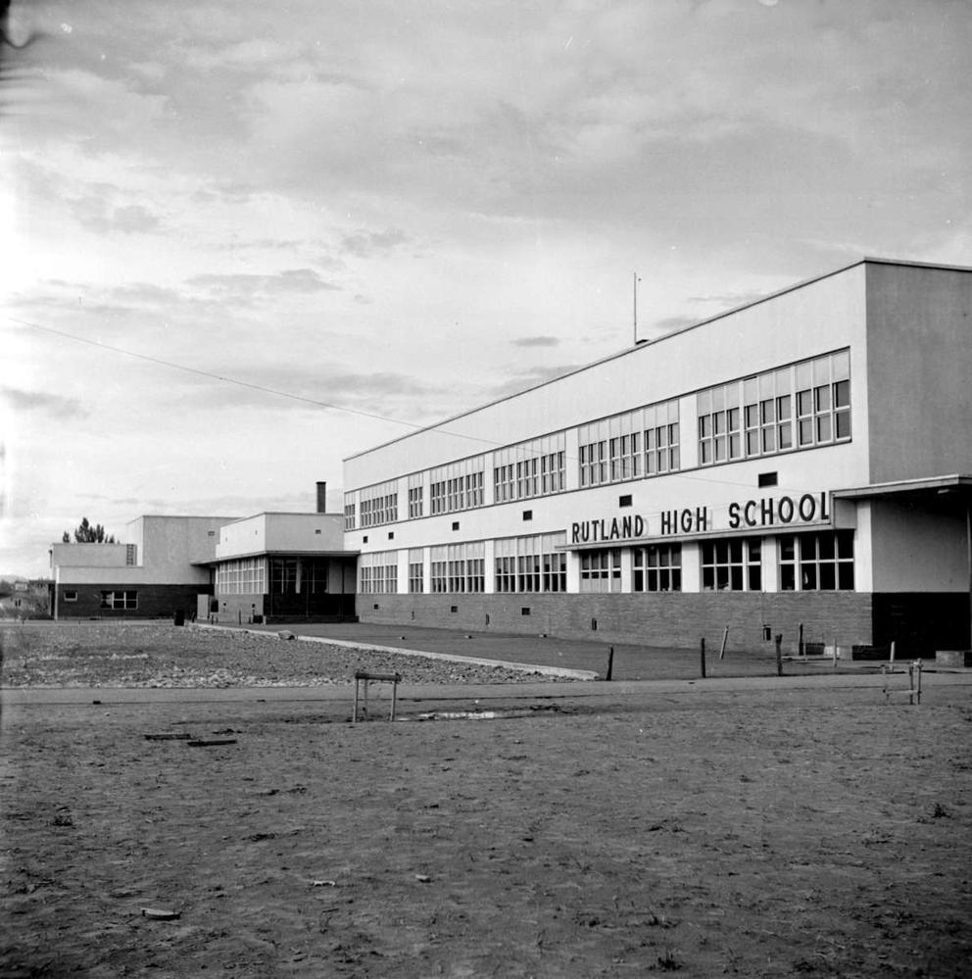
1952 – Rutland High School – BC Archives
https://search-bcarchives.royalbcmuseum.bc.ca/rutland-high-school-3
1952 – Rutland High School – BC Archives
https://search-bcarchives.royalbcmuseum.bc.ca/rutland-high-school-4

Slide 7
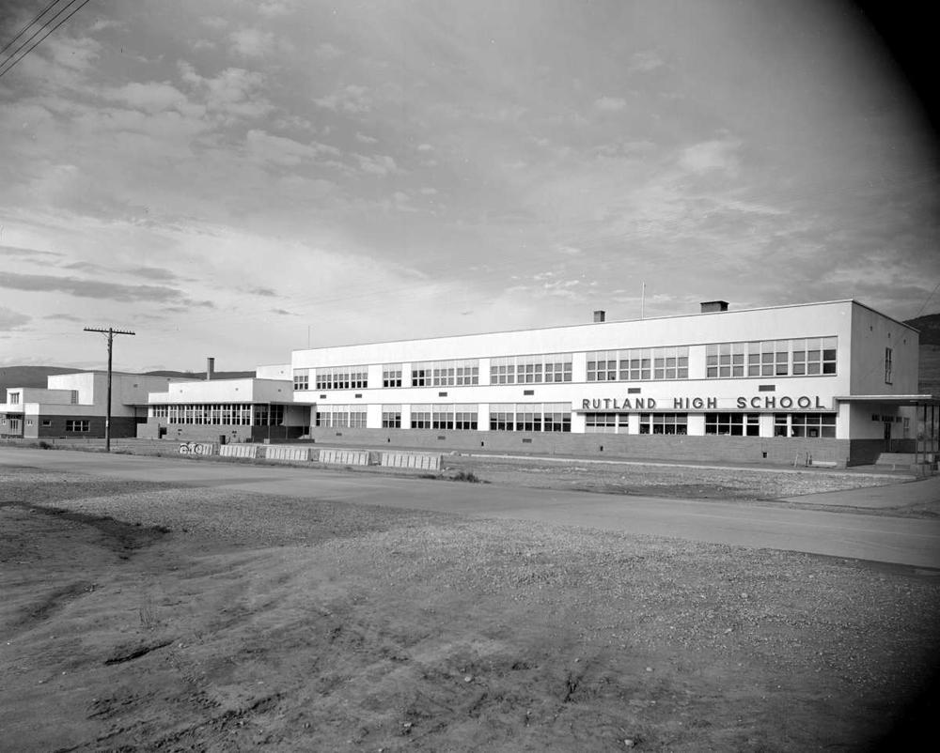
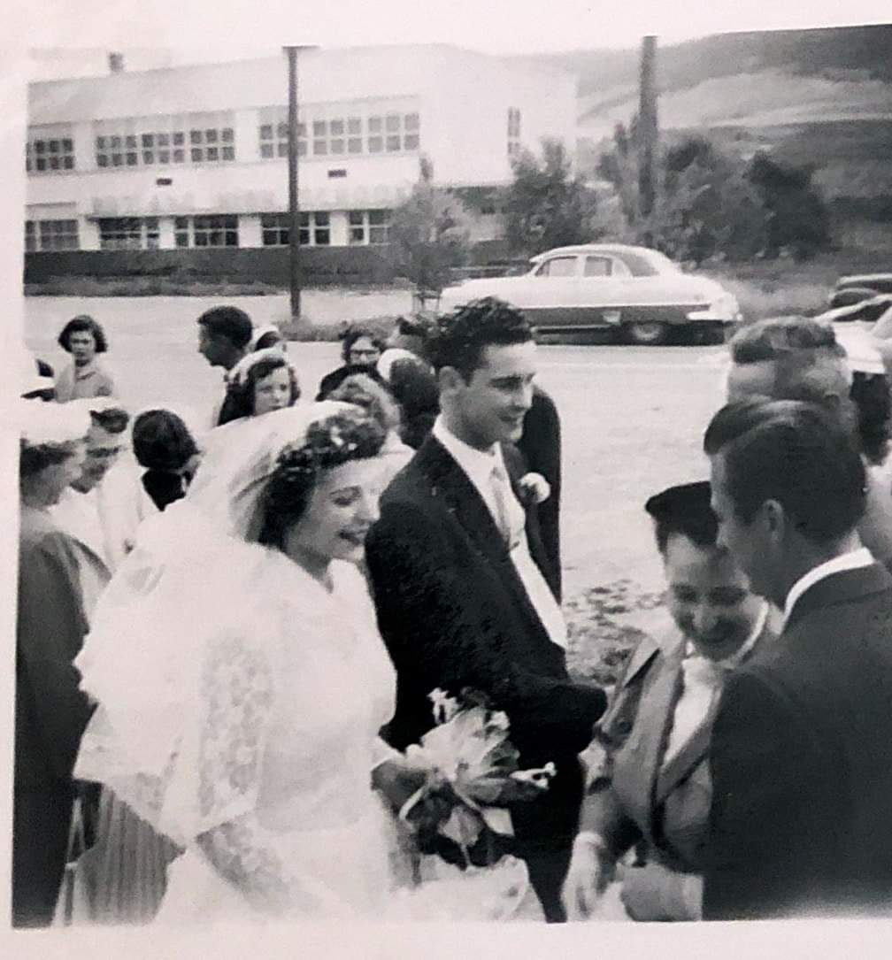
1952– Rutland High School – BC Archives
https://search-bcarchives.royalbcmuseum.bc.ca/rutland-high-school
1957
Jody Dais Grandparents on their Wedding day.
In the background Rutland High School.
Their Great Grand Children attend RMS today.

Slide 8
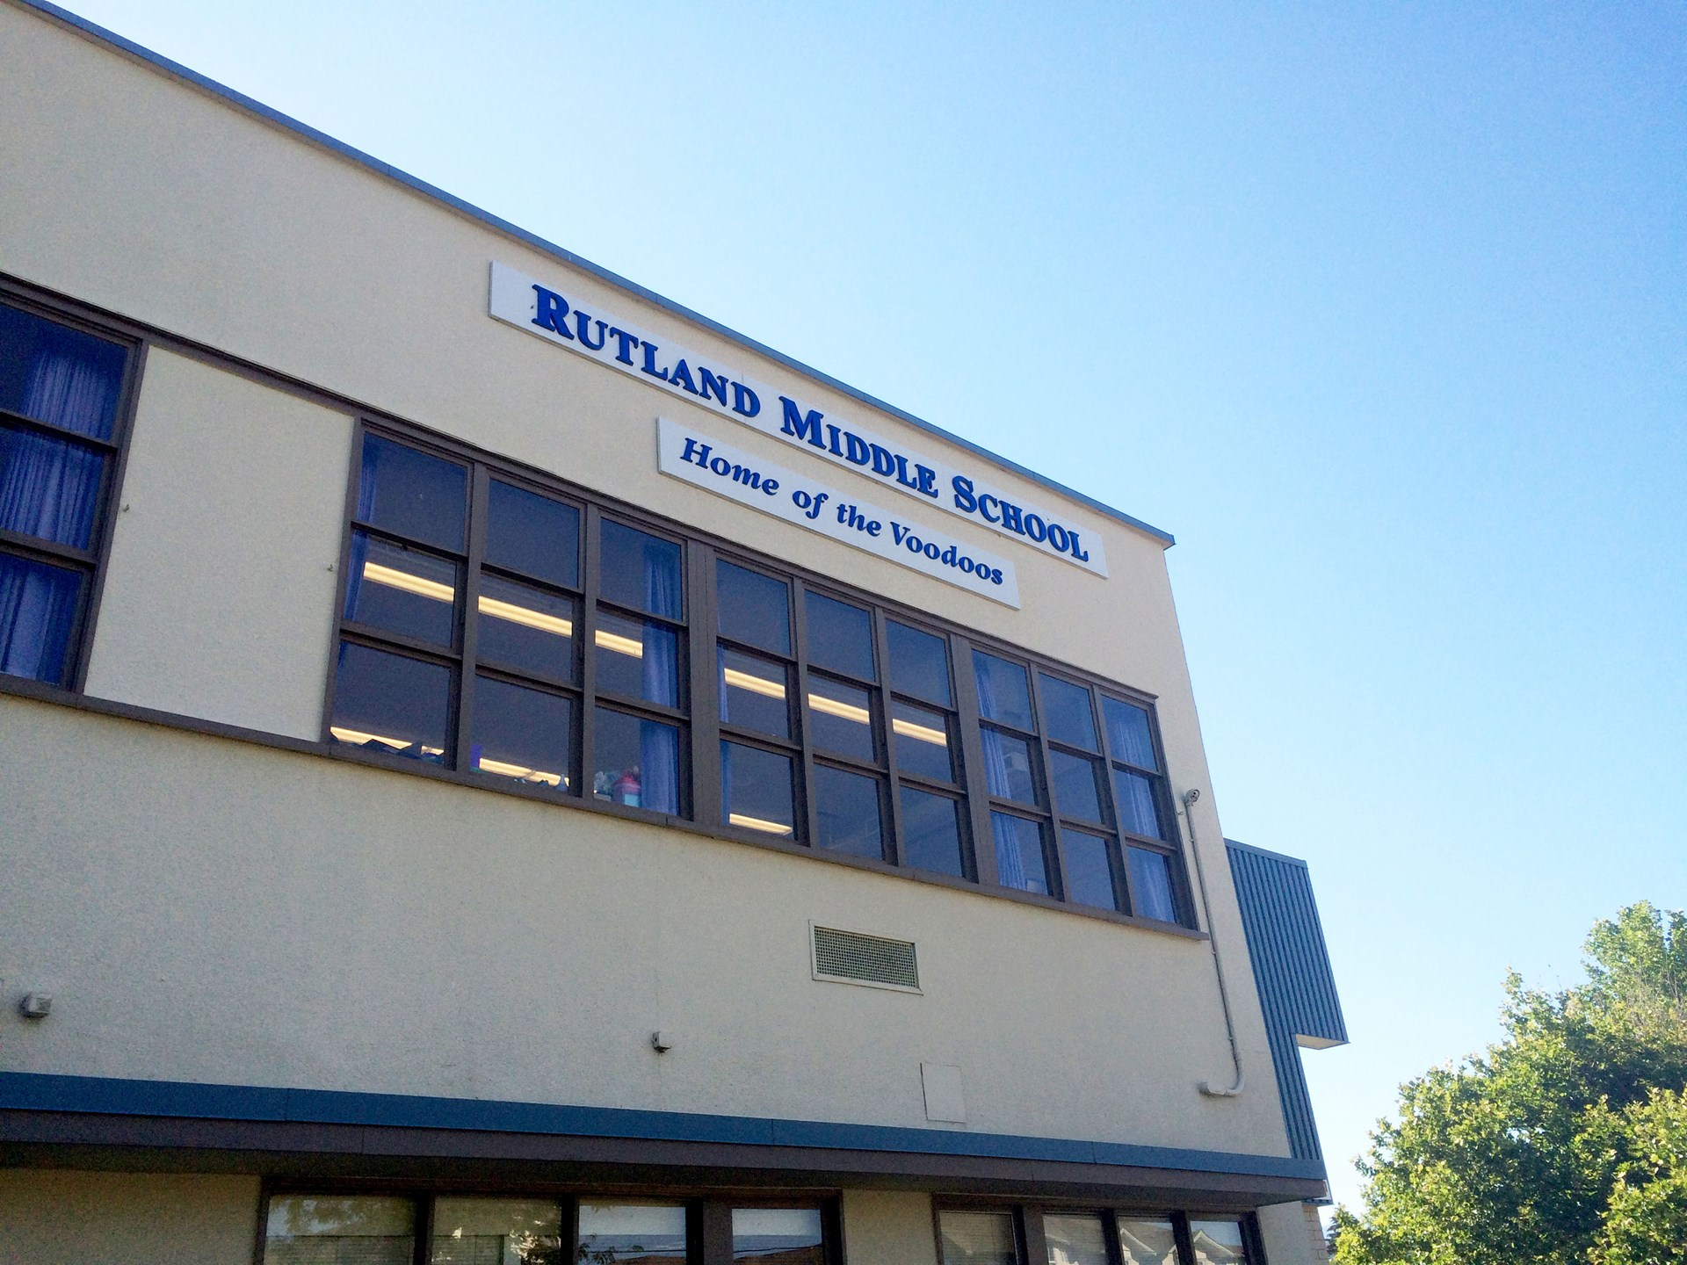
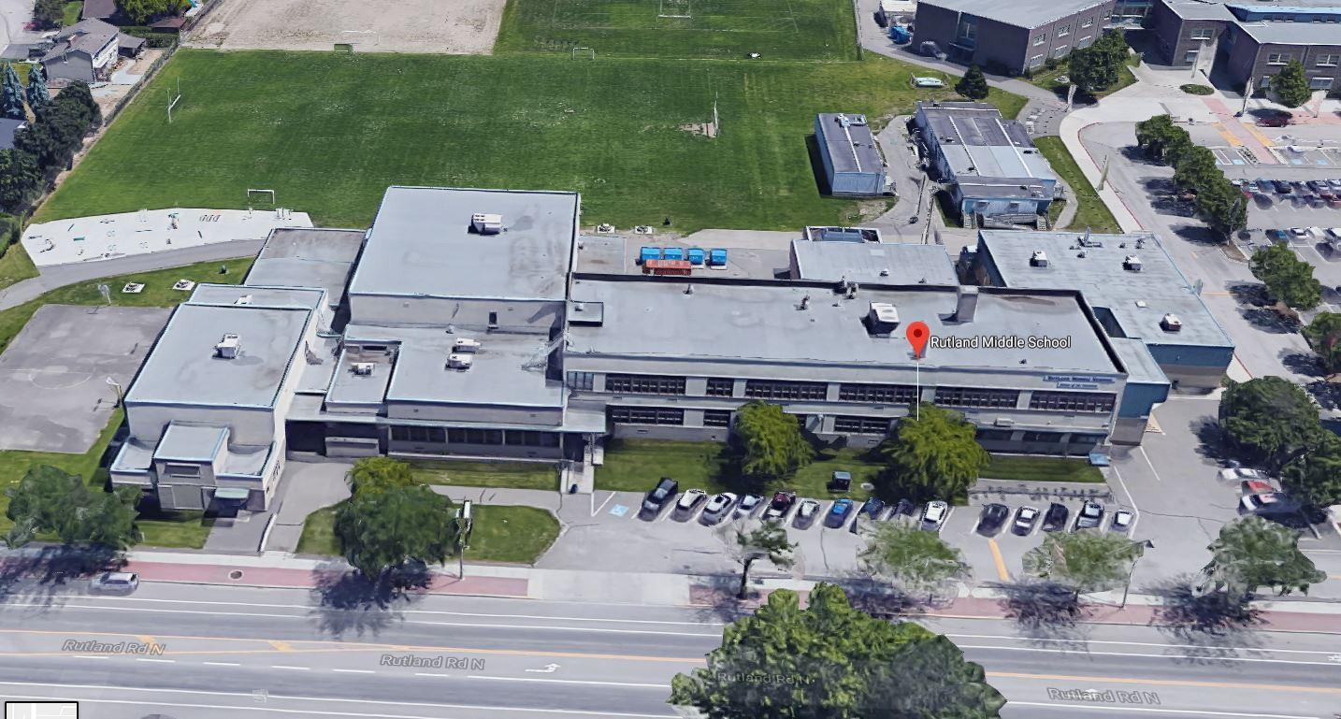
RMS today 2019 – 70 years old
5 Additions since 1949 - wood/metal shop most recent (late 80’s)
Currently has 560 students.
10 portable Classrooms to help accommodate 40-50% of students.

Slide 9
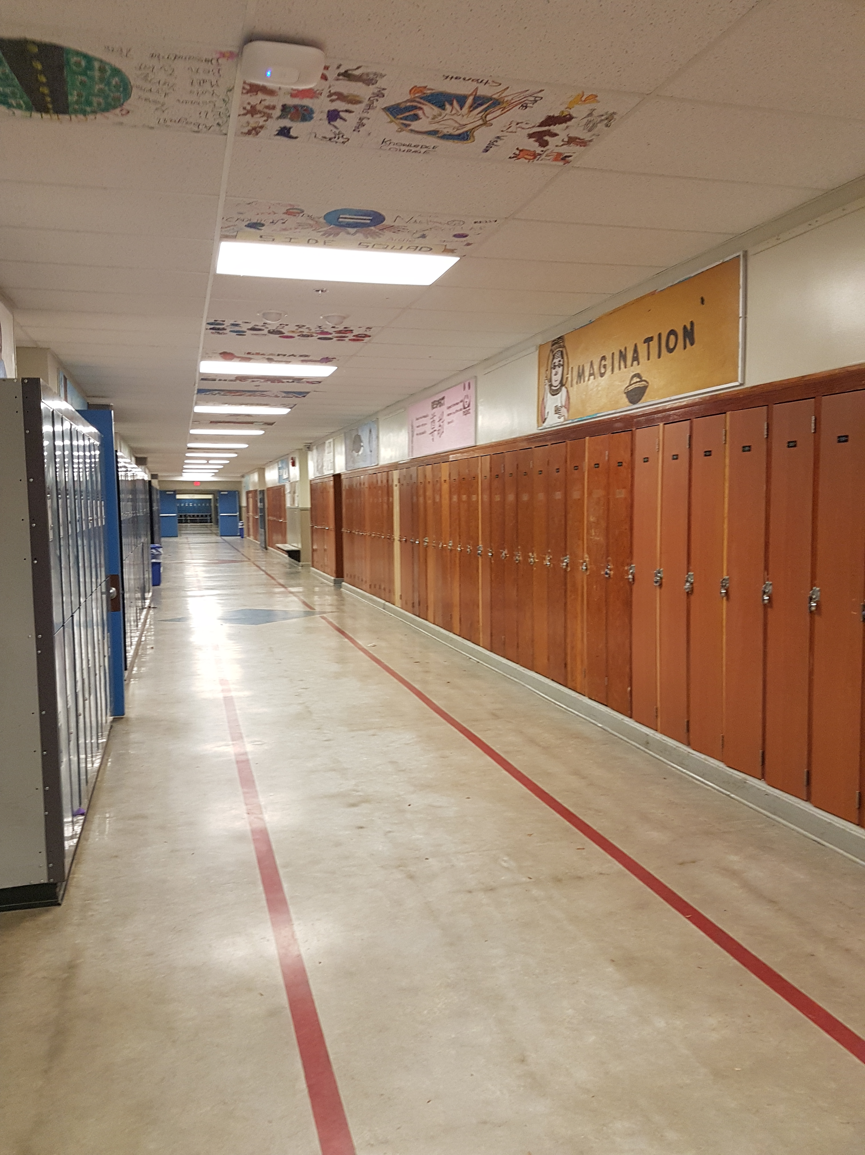
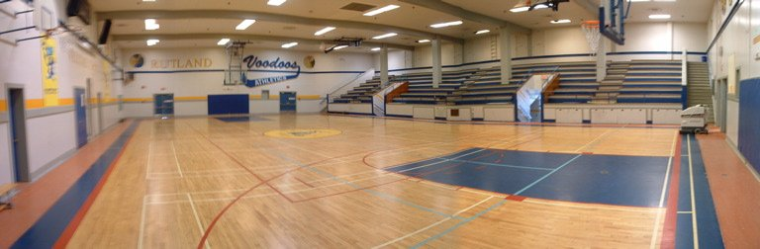
School District 23 & Board Efforts
School District 23 Number 1 priority to be replaced since 2009.
7 Project Identification Reports have been submitted since 2009.
Multiple tours have been given to several Ministers of Education in the last 10 years, as well as the current Liberal Leader.
Multiple Letters advocating for RMS to be replaced have been sent from SD. 23 Trustees to the M of E.

Slide 10
RMS PAC involvement
This year the PAC decided to speak up and begin advocating for RMS to be replaced.
70 years old is too old.
RMS PAC vision for the future of RMS:
To advocate for an environment that supports education, contributes positively to health, safety, inclusiveness and ensures students feel valued as individuals in the larger community.
Actions taken:
Letters to the M of E advocating for our replacement due to the many deficiencies that a 70 year old building has.
MLA & MP lobbying, Media Involvement, School District Board Meetings, School District Meetings with staff and School District Trustee Involvement.
Online Petition: https://www.change.org/p/minister-of-education-rob-fleming-and-premier-john-horgan-replace-rutland-middle-school

Slide 11
Challenges to be Approved
M of E continued to deny project reports (both Liberals & NDP).
M of E states priority to Seismic Mitigation of schools in the lower mainland and the island.
M of E state their other priority are NEW builds and additions over replacement projects such as RMS, to reduce the reliance on portables in growing areas.
Since 2007 School District 23 has received $131.26 million for 6 projects:
Mar Jok Elementary, Canyon Falls Middle School, Lake Country Middle School, Okanagan Mission School(addition), Chute Lake Elementary, and Mount Boucherie Secondary (addition).
In the last 5 years (approx.) less than 10% of the Capital Project Funds from M of E were allocated to School Districts outside the lower mainland or the island.
Within this 10% is Canyon Falls & Lake Country Middle Schools were included.

Slide 12
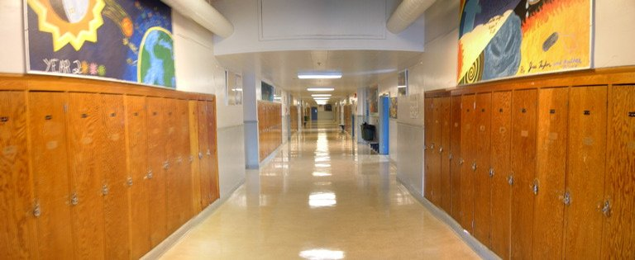
Other Challenges
Rutland area is growing at a steady pace – due to high density new builds (condos and townhomes), and affordability to live in Rutland. Which ultimately means more portables at RMS, unless RMS is replaced.
Lack of land to build a NEW school.
Difficult for the School District to plan what upkeep and maintenance needs to be completed when there is always a possibility to be replaced.
RMS is not on the SD. 23 Capital Budget (2017-2022) for any major projects (this is currently under review).

Slide 13
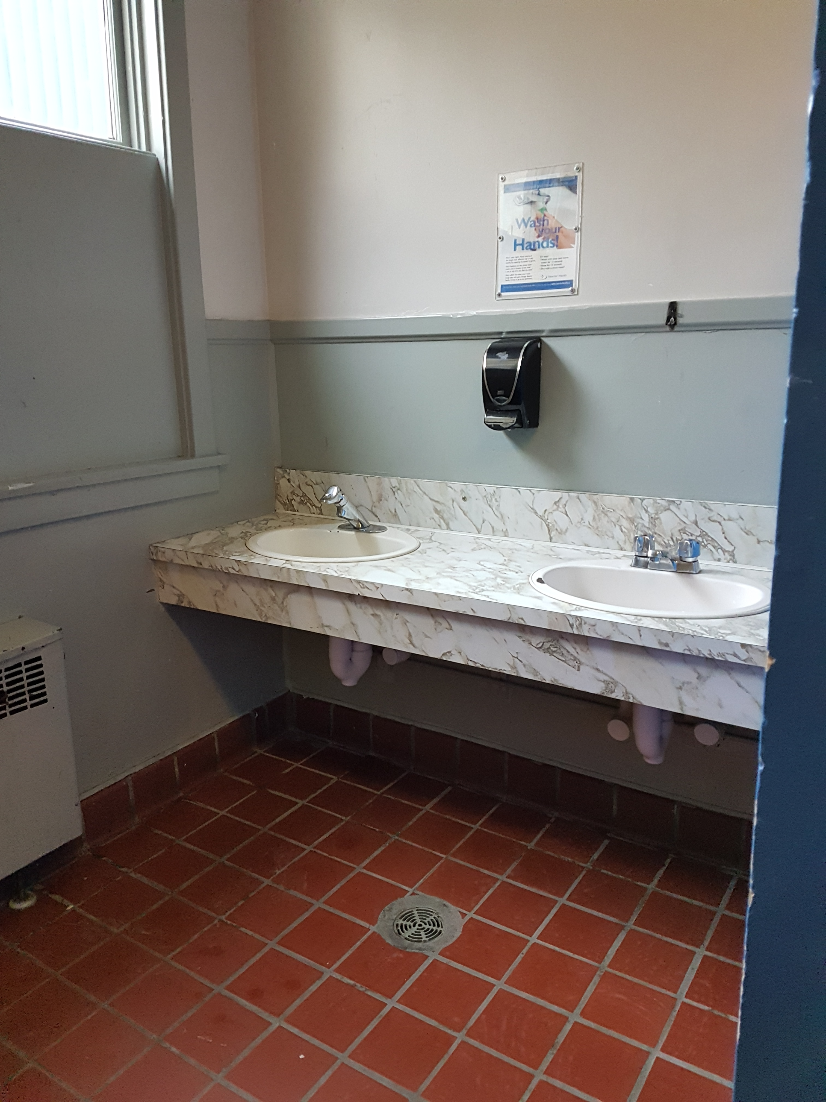
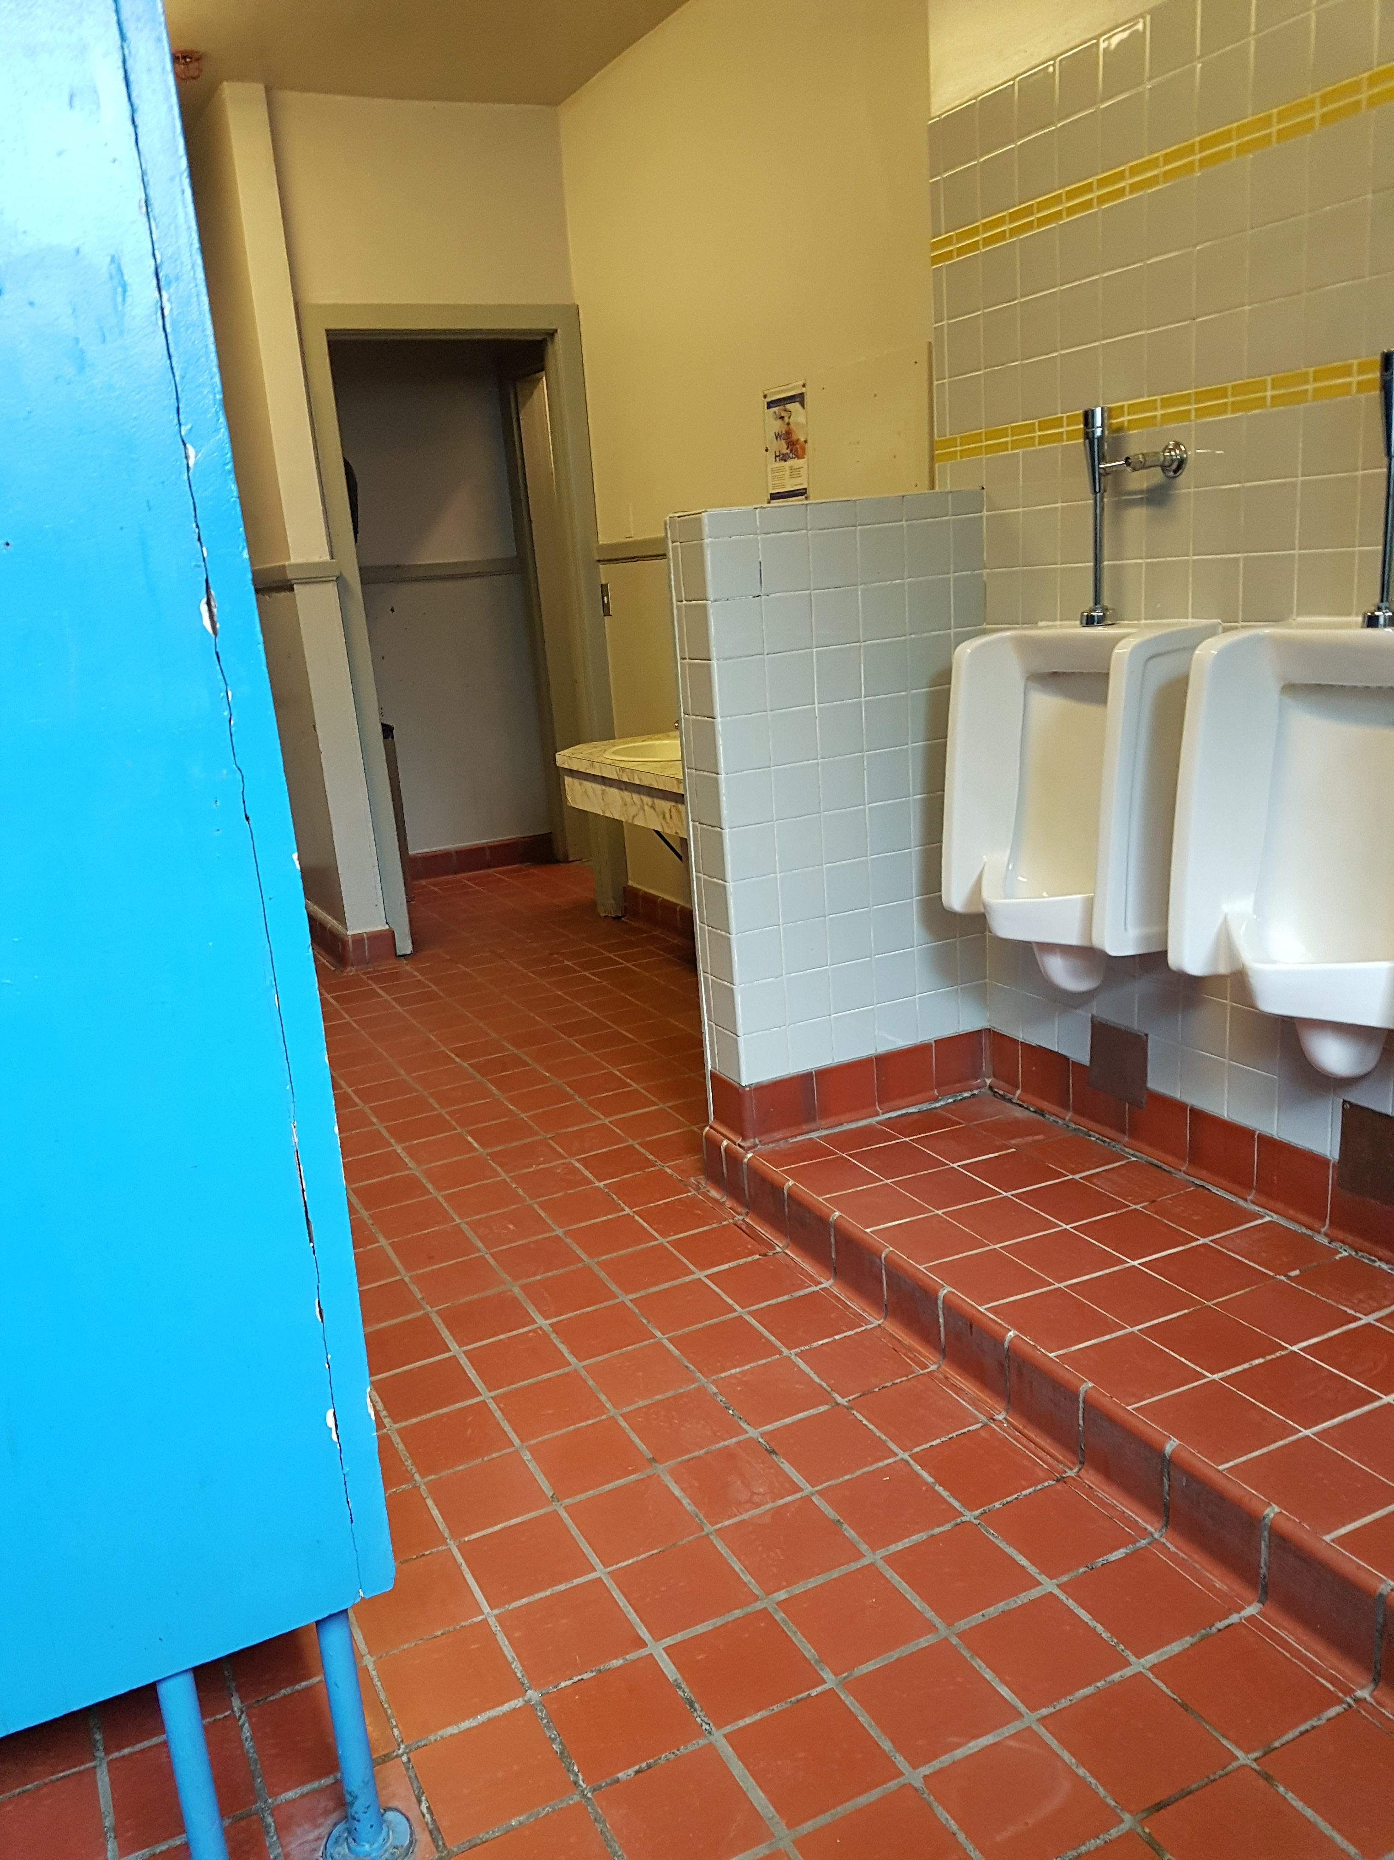
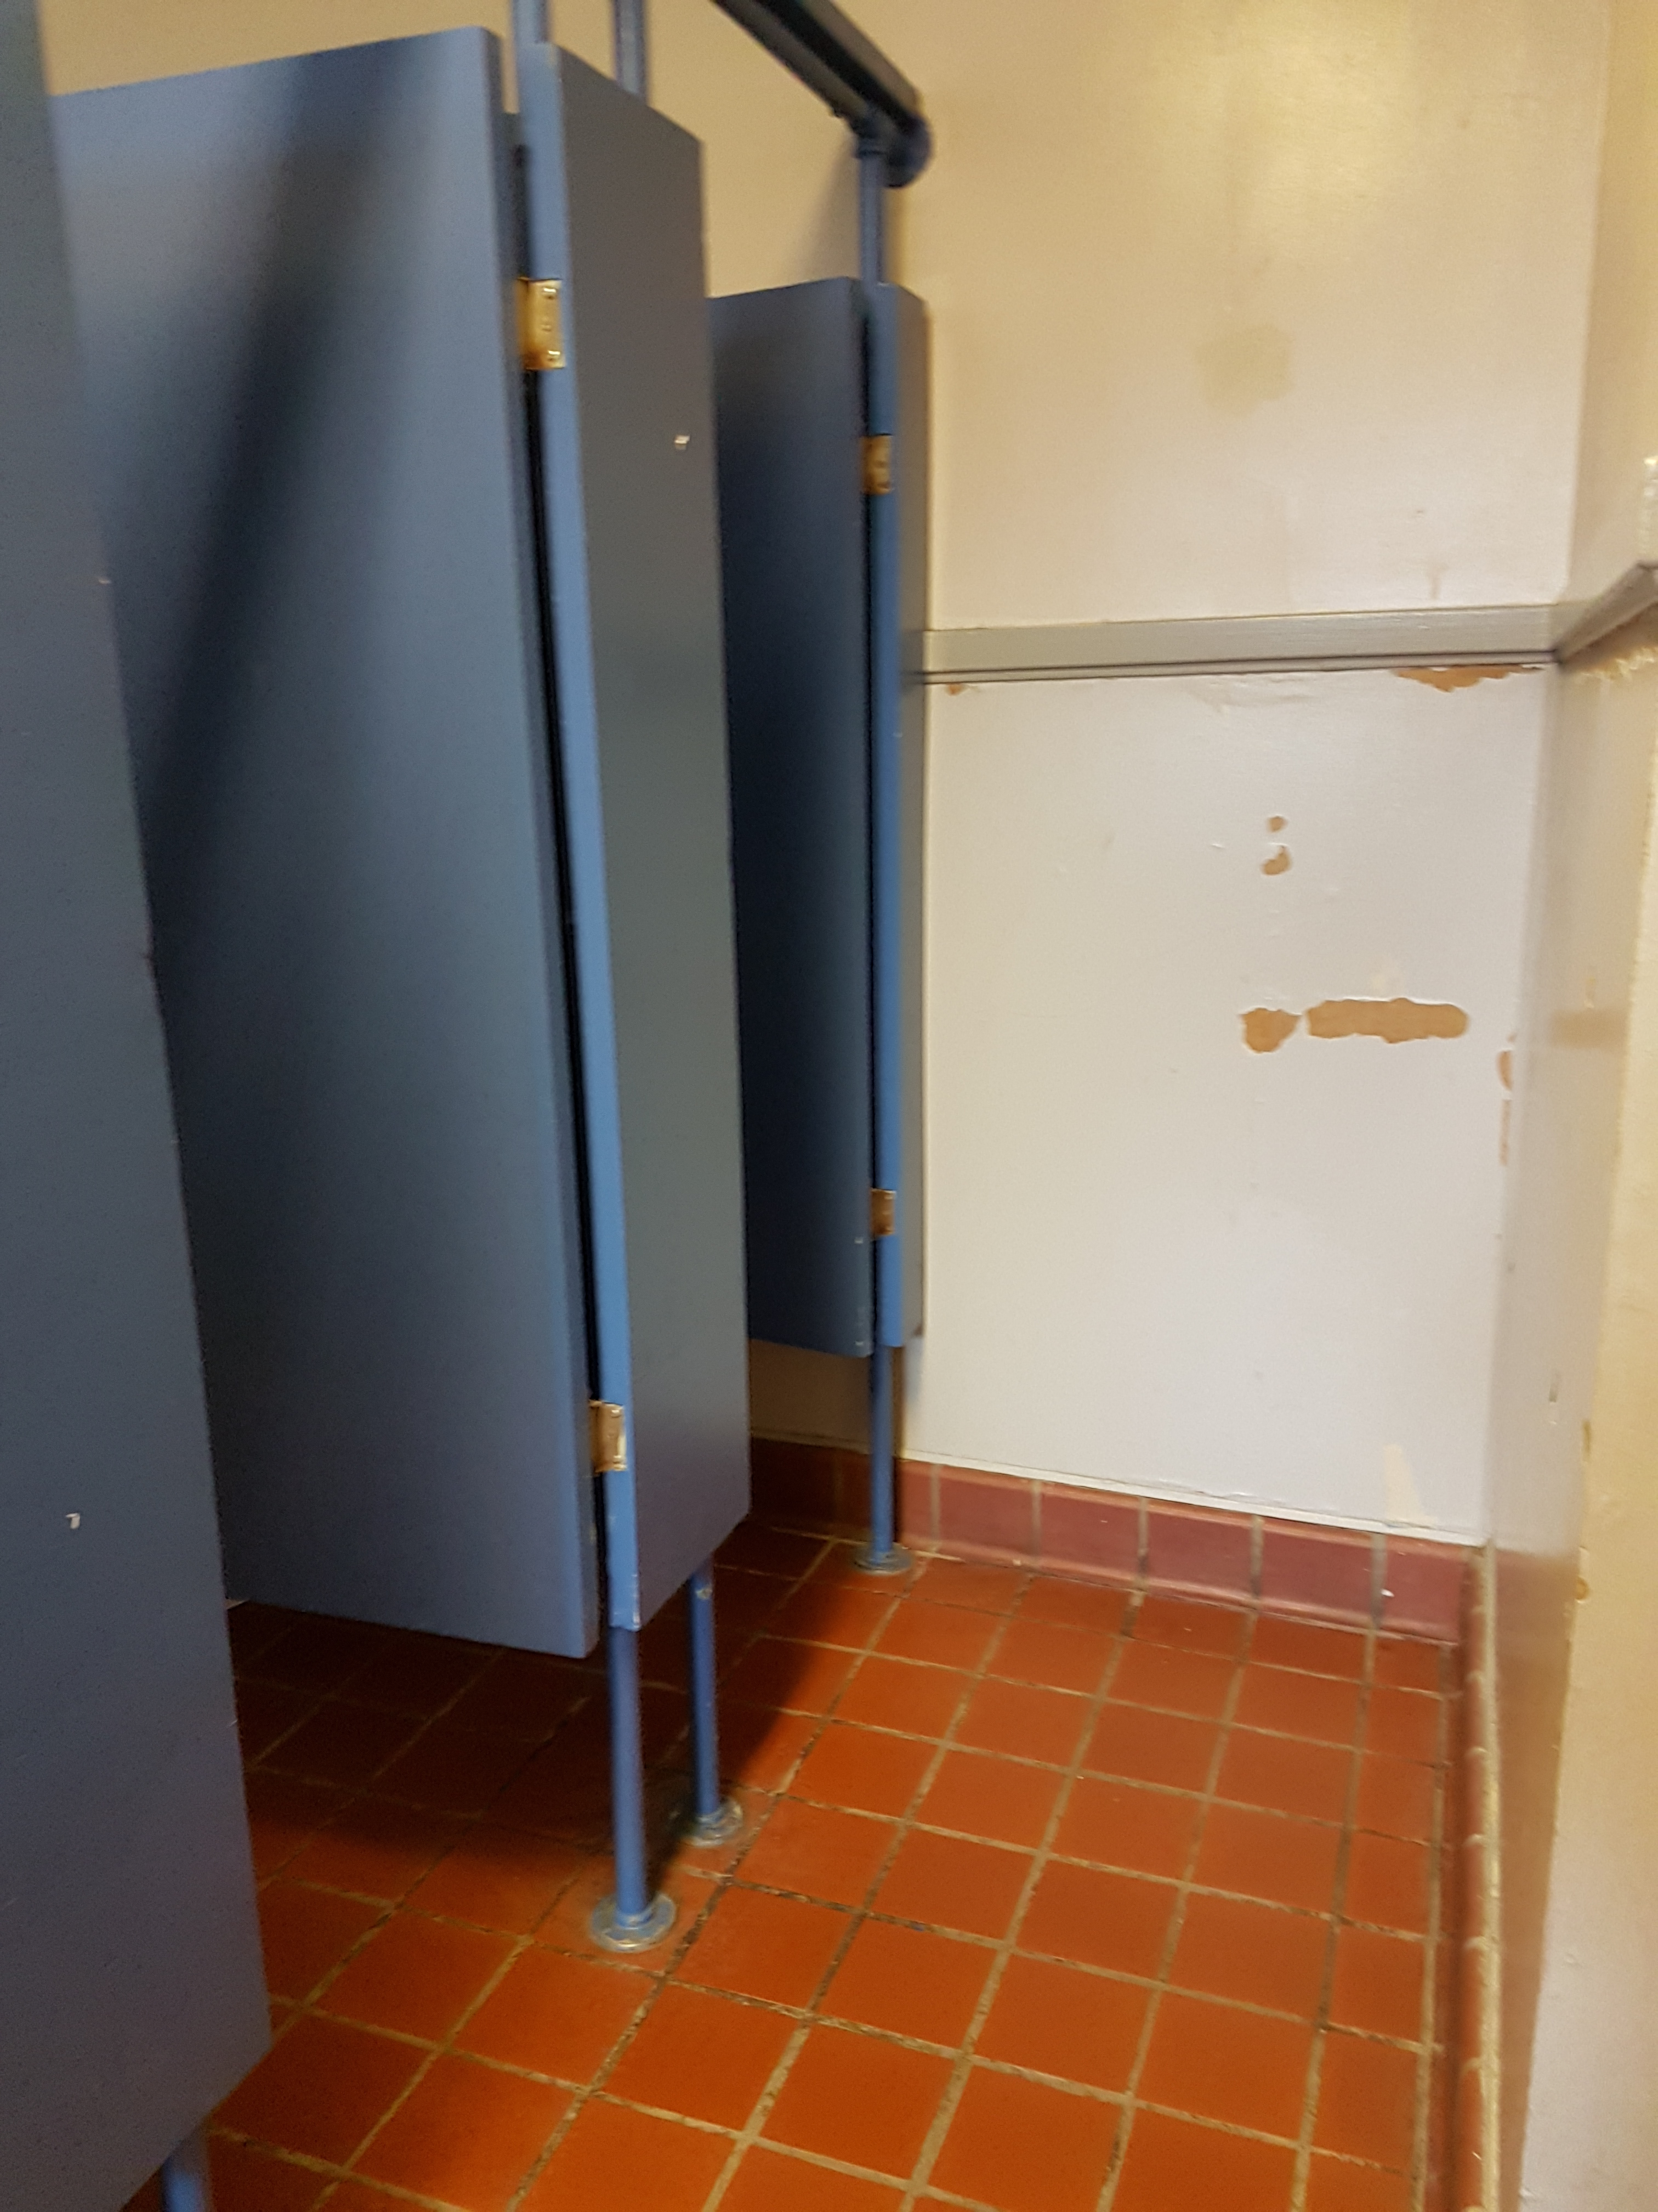
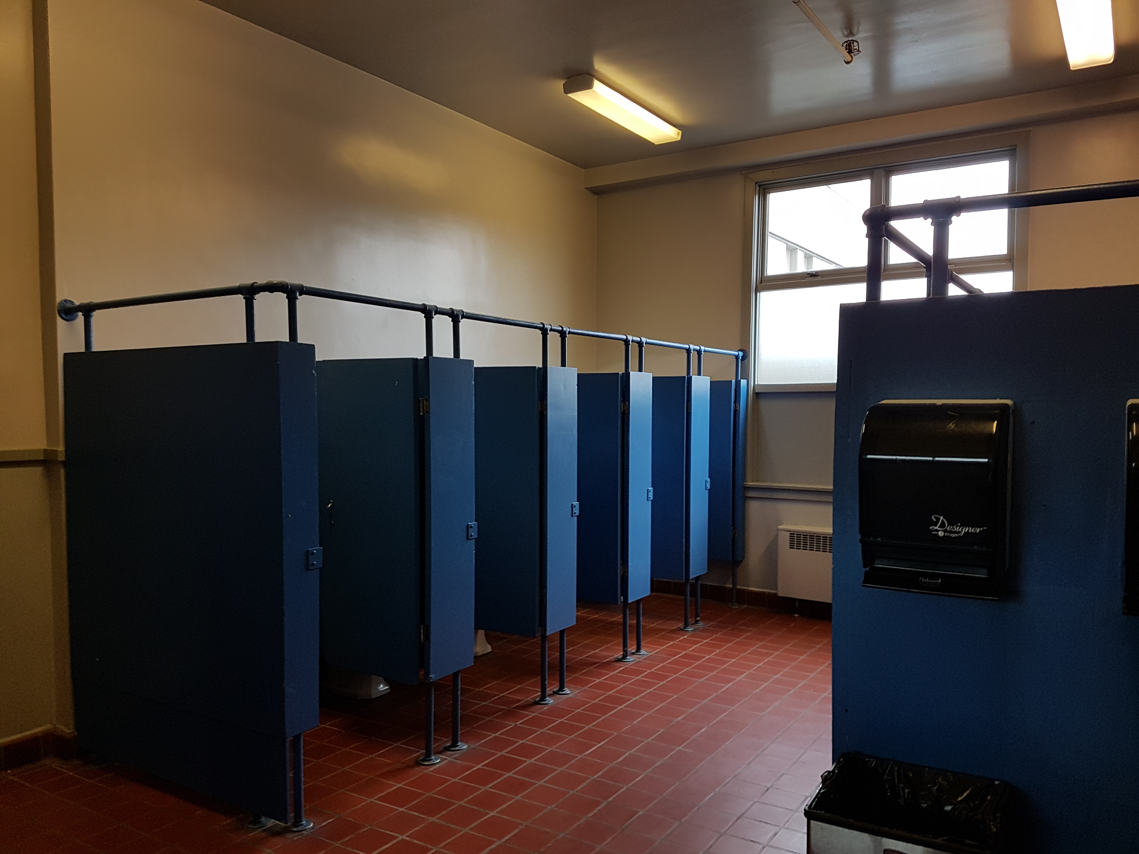
Other things to consider
An Ontario Parent Advocacy Group (grass roots, non-partisan) – “Fix our Schools” found in 2014 that Ontario Provincial Government only provided School Districts 1/10th of the industry standards to maintain schools.
In 2014 Fix Our Schools started advocating in Ontario to improve these funds. They have managed to improve the funds school districts receive by 10 times (2014 $150 million, now $1.4billion). However, there is still a 15.9billion repair backlog currently in Ontario. http://fixourschools.ca/
British Columbia is in a similar situation – many schools throughout the province have been “neglected” due to lack of funds the School Districts received by previous governments. Deferred maintenance has been a chronic issue over the last 15 years.

Slide 14
Legislative Assembly of British Columbia 3rd Session of the 41st Parliament
Select Standing Committee on Finances & Government Services
One of ten permanent all-party committees of the Legislative Assembly of BC.
The Committee holds annual public consultations on the provincial budget.
Consultation for 2019 Budget occurred in Fall of 2018
Committee has recommend an increase in capital funding to school districts to build NEW schools, maintain and upgrade existing facilities, conduct seismic upgrades, and add classroom space and playgrounds.
School Districts from Surrey, Peace River North, Coquitlam, Southeast Kootney, Mission, Vancouver, Richmond and Prince George participated in the consultation process.
NO Okanagan School Districts were part of this process.
WHY NOT?

Slide 15
School District Trustees & Staff Communication & Input
Questions from Parents.
Going forward what else can we do?

Slide 16
Schools that are well maintained, safe, inclusive, healthy and support the delivery of education need to be valued as a key infrastructure by the Municipal, Provincial and Federal Governments.
It’s about doing the right thing.

